Slide 1

Intelligent File Organizer
Wei Guo
2019-03-29

Slide 2
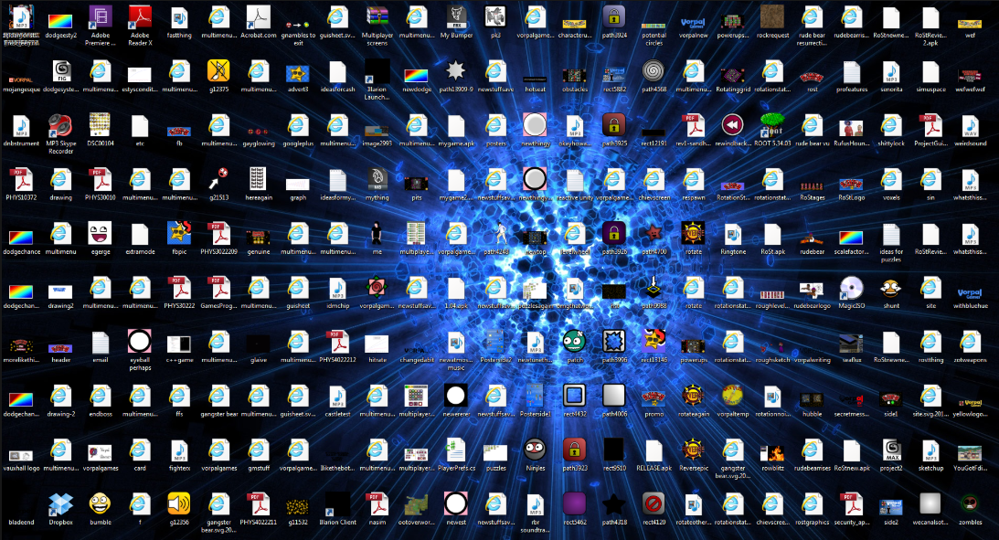
How to clean this up?

Slide 3
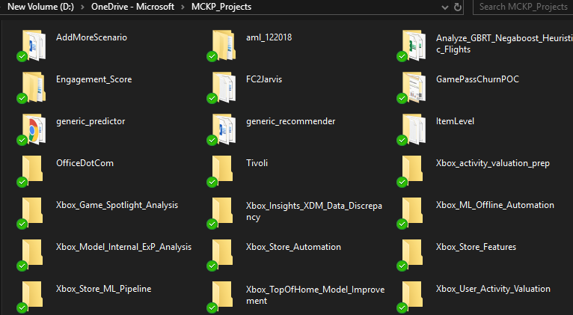

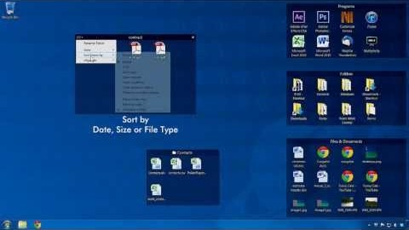
Windows: manually create folders to organize files
There are some solutions:
macOS Mojave: Stacks
Automatically organize desktop icons: Fences

Slide 4


However …
Files are simply grouped by file type
pptx, docx, pdf, etc.
modified date/author
Labor intensive
Loop through each file
Create meaningful groups
Assign each file into those groups
Not considering the file itself
What is this file about?
Is it similar other files?

Slide 5

My solution
Ingest
intelligence using ML and NLP techniques
Extract
information from files to build file representation
Build
un-supervised learning solution to group files

Slide 6
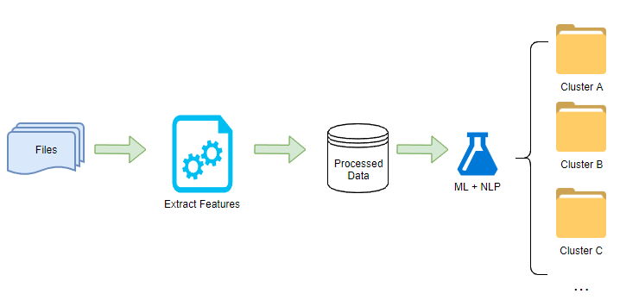
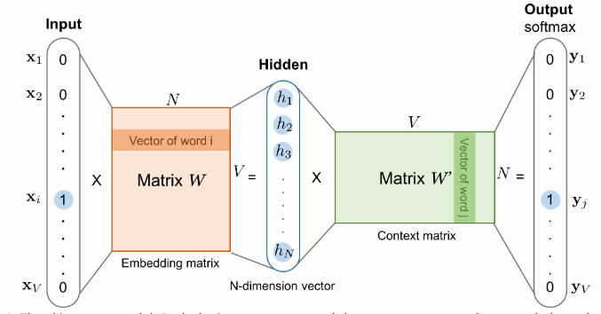
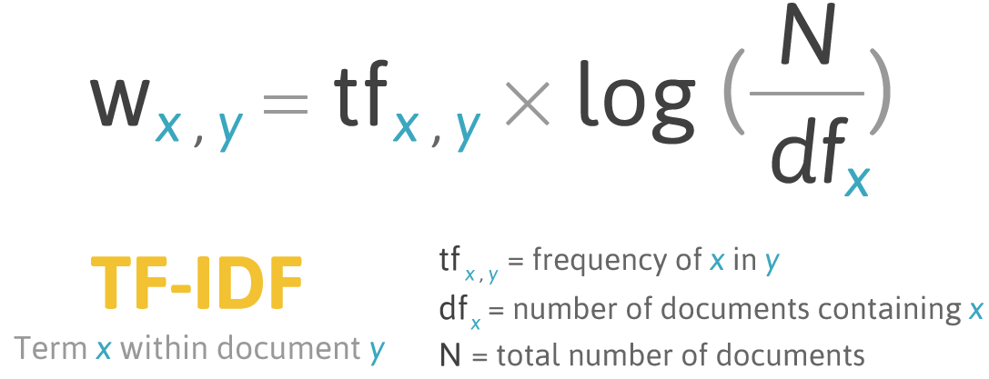
Project flow
Feature set
Word Embedding

Slide 7
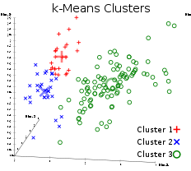
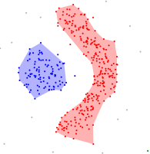
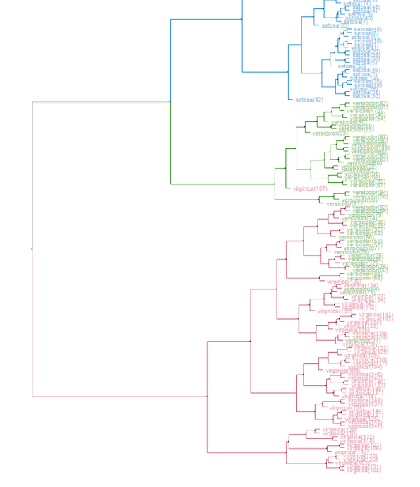
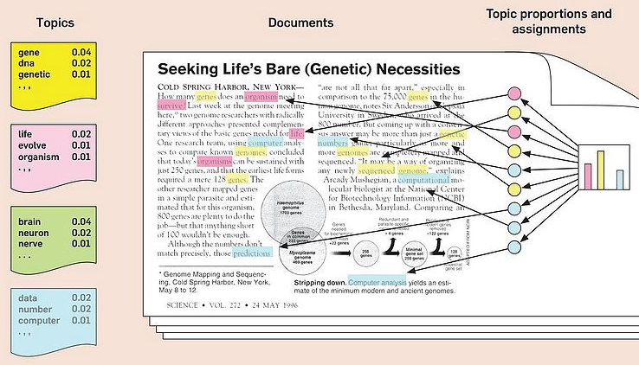
Clustering Methods Explored
K - Means
DBSCAN
Hierarchical
LDA

Slide 8
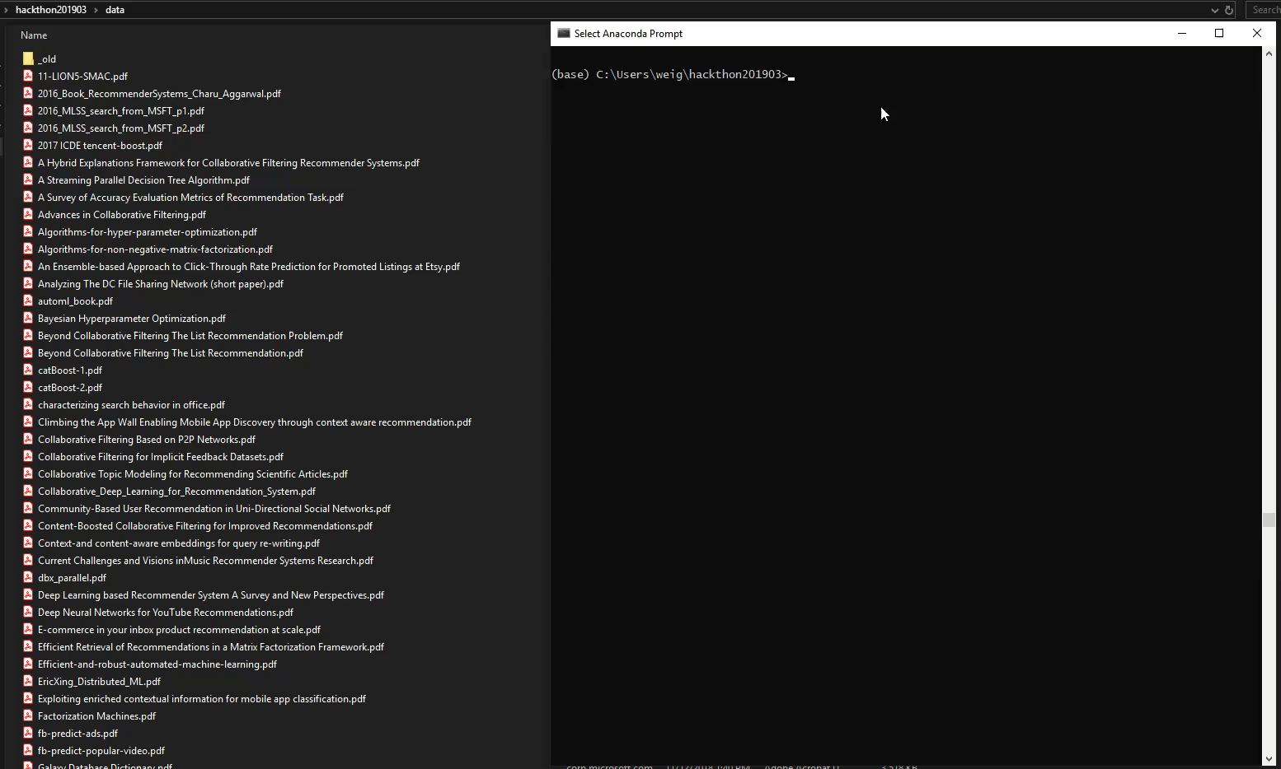
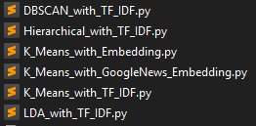
What does my solution look like?

Slide 9
Challenges & Learnings -Unsupervised learning is HARD!
No ground truth, how good my model is?
There are some evaluation metrics such as Sihouette Coefficient, but not intuitive and helpful for improving models.
Better metrics may not lead to results that look reasonable to users.
How to choose number of clusters?
Elbow chart sometimes not so helpful
Always decrease as num cluster increases in one of my cases
May need some heuristics
Total number of files at hand
Ask users how many groups they want
Create meaningful feature from short file name is challenging
Randomness in some algorithms
Initial values setting
*Details in Jupyter Notebook, available for reference

Slide 10

Next Step
Improve models
Text processing
Model parameters
Other models
Extract text from document content
Different file type extractor
Create meaningful folder names
From key words in each cluster
Include user feedback to improve model
Reinforcement learning may help
Build application
Desktop app
Add to right click menu
Train embedding within substrate
Within your file system
In your organization
Join me to hack in the summer!

